Slide 1

Research Proposal
SEScore 2.0

Slide 2
Background
SEScore –
Stratified dataset synthesis pipeline
Sentence corruption
Error scoring via entailment
Accumulation of errors.
Fitting a model to learn the scores and function as the metric
MQM – A linguistic evaluation of errors in sentences
Categorizes error as “severe” (Accuracy) and “not severe” (Fluency)

Slide 3
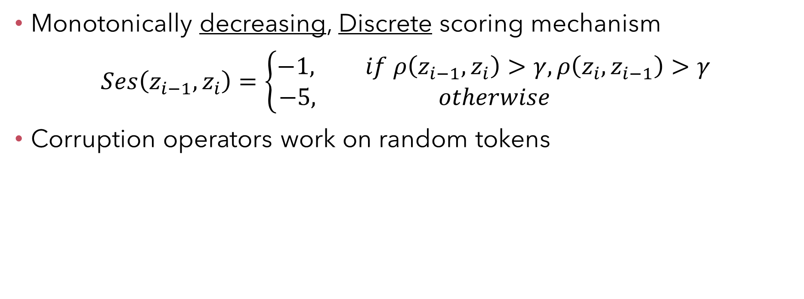
SEScore Limitations
Monotonically decreasing, Discrete scoring mechanism $Ses\left(z_{i−1},z_{i}\right)=\left\{\begin{aligned}−1, if ρ\left(z_{i−1},z_{i}\right)>γ, ρ\left(z_{i},z_{i−1}\right)>γ \\ −5, otherwise \end{aligned}\right.$
Corruption operators work on random tokens

Slide 4
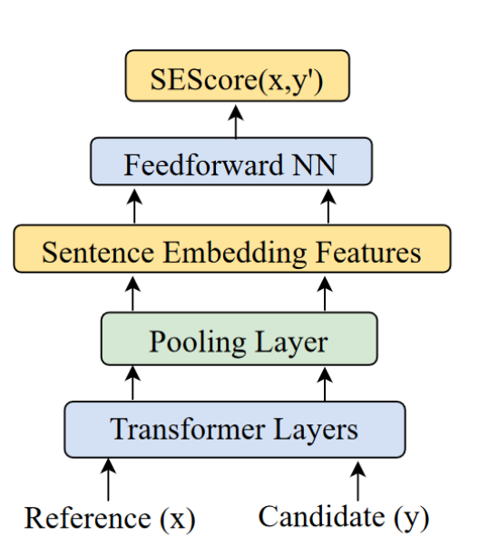
Our task
Improve SEScore to even better correlate with human scores

Slide 5
Proposed Changes - Operators
Smarter Masking
Taking advantage of PMI Masking
Original: “Ofek flew to New York City”.
Random masking: “Ofek flew to New <mask> City”.
PMI masking: “Ofek flew to <mask> <mask> <mask>.
Expanding the “replacement” operator to replace words with synonyms (Regardless of context). “Ofek ran to the store” -> “Ofek ran to the stock”
“Grammatical Corruption” operator via lemmatization “Ofek walked to the store” -> “Ofek walk to the store”

Slide 6
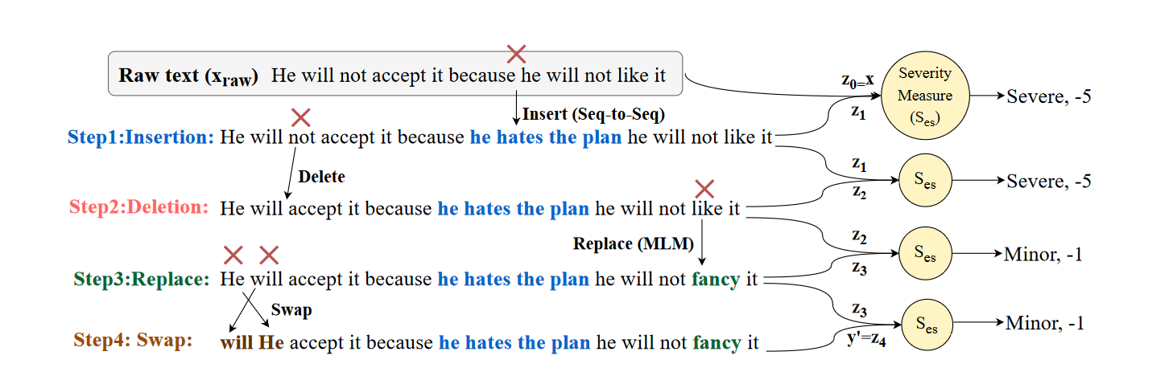
Proposed Changes - Scoring
Introduce a non-monotonical scoring mechanism (Identifying improvements relative to the original sentence)
Introduce a continuous severity score (by confidence of entailment)

Slide 7
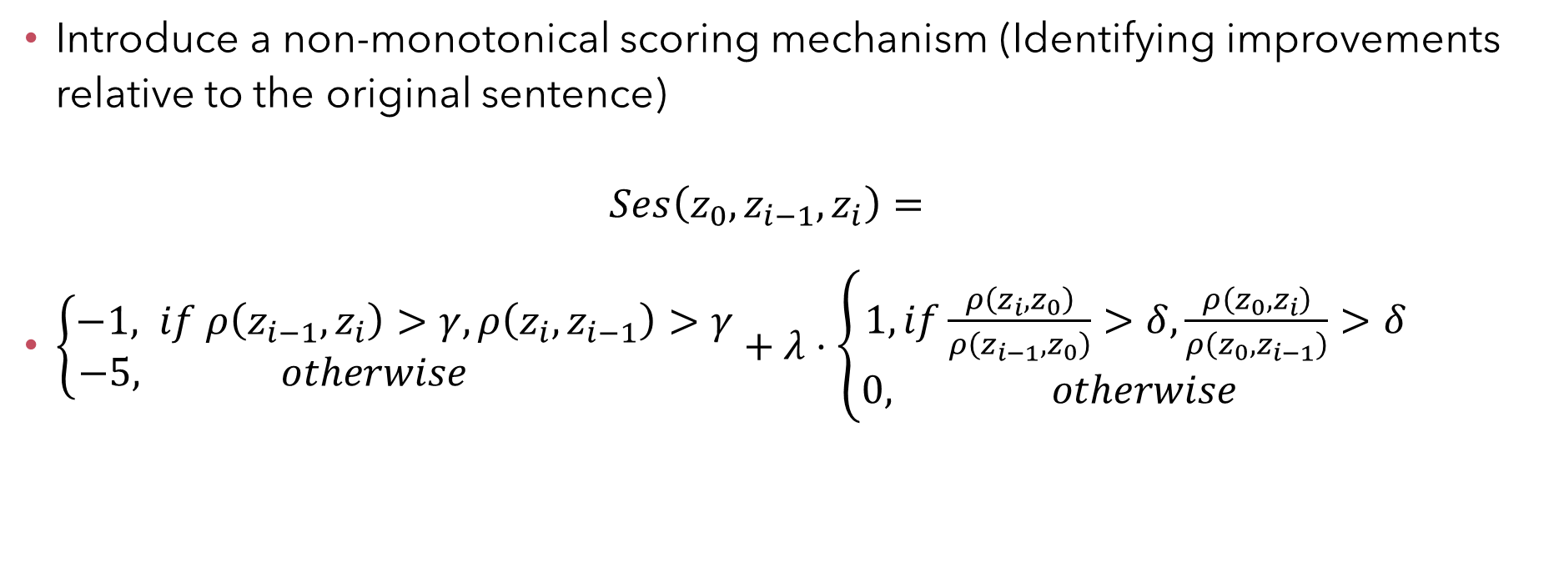
Non-monotinicity
Introduce a non-monotonical scoring mechanism (Identifying improvements relative to the original sentence) $Ses\left({z_{0}, z}_{i−1},z_{i}\right)=$
$\left\{\begin{aligned}−1, if ρ\left(z_{i−1},z_{i}\right)>γ, ρ\left(z_{i},z_{i−1}\right)>γ \\ −5, otherwise \end{aligned}\right.+λ⋅\left\{\begin{aligned}1,if\frac{ρ\left(z_{i},z_{0}\right)}{ρ\left(z_{i−1},z_{0}\right)}>δ,\frac{ρ\left(z_{0},z_{i}\right)}{ρ\left(z_{0},z_{i−1}\right)}>δ \\ 0, otherwise \end{aligned}\right.$

Slide 8
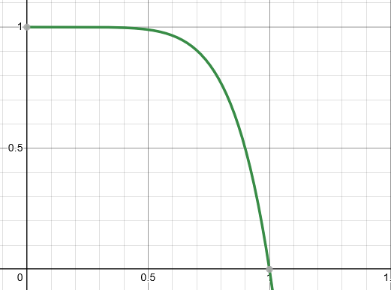

Continuous Severity Score
Introduce a continuous severity score (by confidence of entailment) $Ses\left(z_{i−1},z_{i}\right)=1−BDE{\left(z_{i−1},z_{i}\right)}^{n}$ *BDE – Bi-Directional Entailment
Notes:
N=6.5788
The desired behavior would be that low BDE would be greatly punished and high BDE would result in a low severity score.
Low BDE would be punished similarly.

Slide 9
Datasets
To train the entailment model: MNLI(Multi-Genre Natural Language Inference)
Datasets for reference sentences: WebNLG
Notes:
לשאול על הדאטאסטים
WEBNLG – Ask how to average scores among many submissions

Slide 10
Basic Part
The baseline:
Dataset generation:
Uses 4 operators (“Insert”, ”Delete”, ”Swap”, ”Replace”).
Operators work on non overlapping tokens.
Entailment model assess error severity and scores accordingly.
Implement proposed operator changes (PMI, Synonyms, lemmatization)
Learning evaluation metric:
Use pairs of candidate and reference sentences to produce features from PLM.
Train a model using the extracted features and the scores generated.

Slide 11
Advanced Part
Scoring mechanism changes
Continuous scoring mechanism
Non-monotonic scoring mechanism
Possible combination of the two
Ablation experiments (?)

